Slide 1

COP 6731: Theory and Implementation of Database Systems
File and Index Structures

Slide 2
Outline
Goal:
Learning storage and access methods.
Physical Level
Primary Index
Clustering Index
Multi-level Index
B+ tree
External Merge Sort

Slide 3
Primary Index
Primary index is an ordered file.
Ordering key
Pointer to a disk block
Data File
Index File
The total number of entries in the index is the same as the number of disk blocks in the data file.

Slide 4
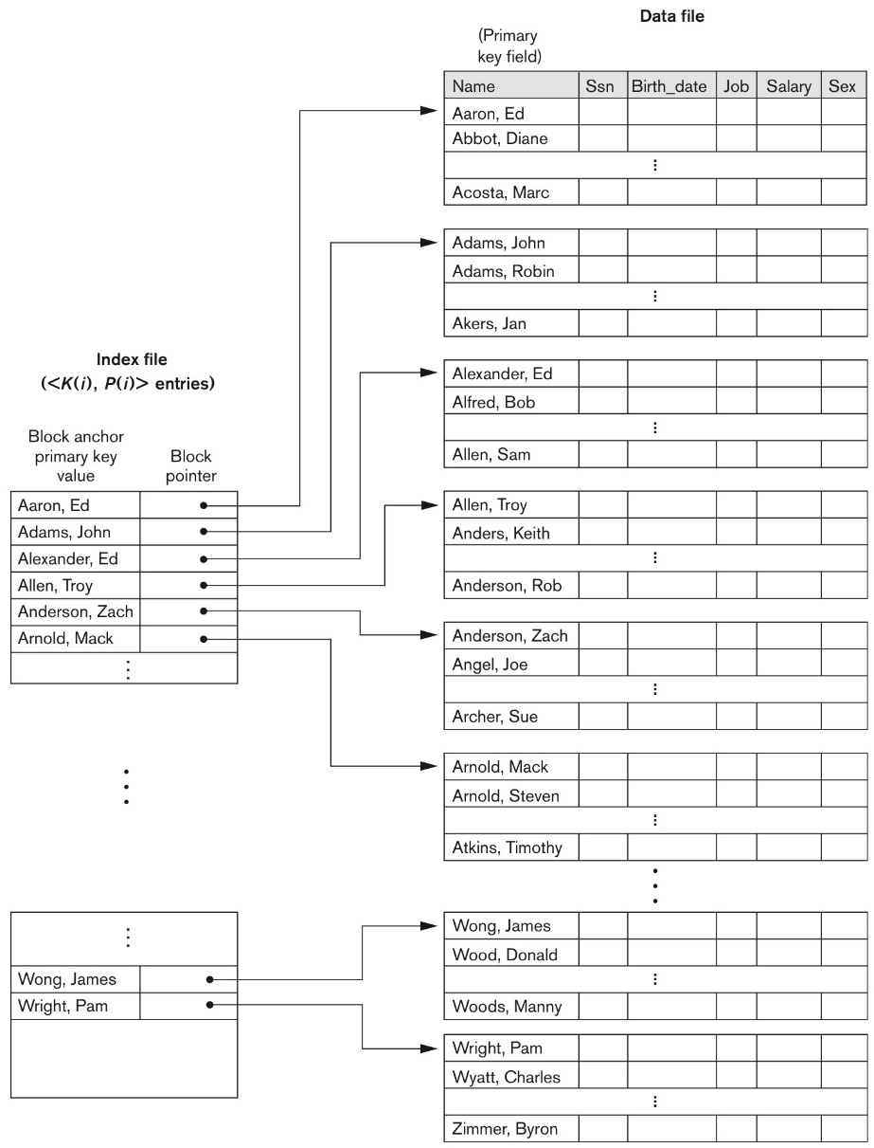
Primary Index
Primary Index is one whose search key specifies the sequence order of the file.

Slide 5
Clustering Index
Value of Key field is not unique in Data File (Non-key field).
Clustering field value
Pointer to the first disk block
Data File
Index File

Slide 6
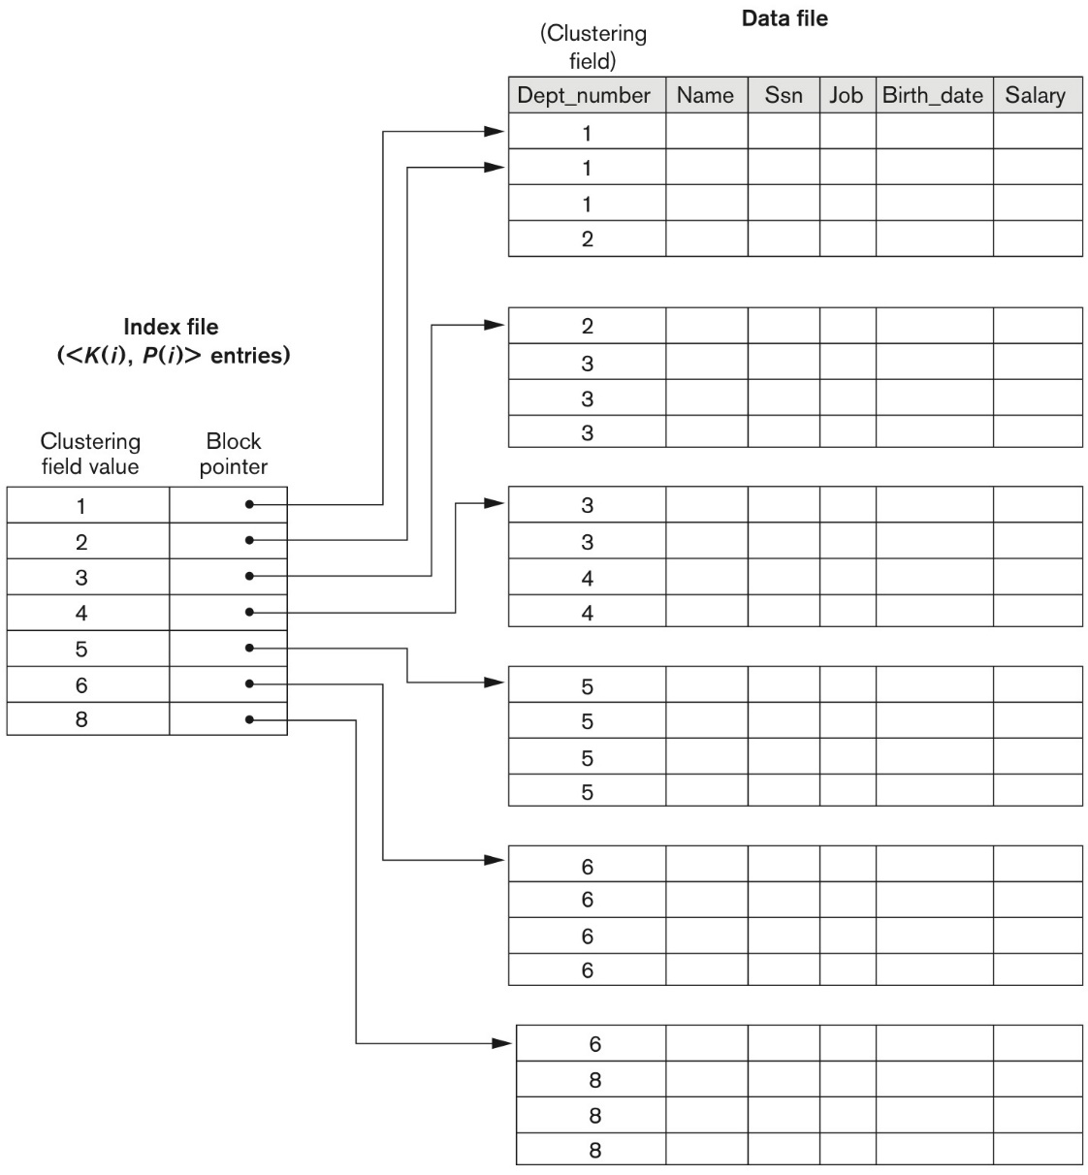
Clustering Index
A clustering index determines how rows are physically ordered (clustered) in a tablespace. The clustering index provides significant performance advantages in some operations, particularly those that involve many records.

Slide 7
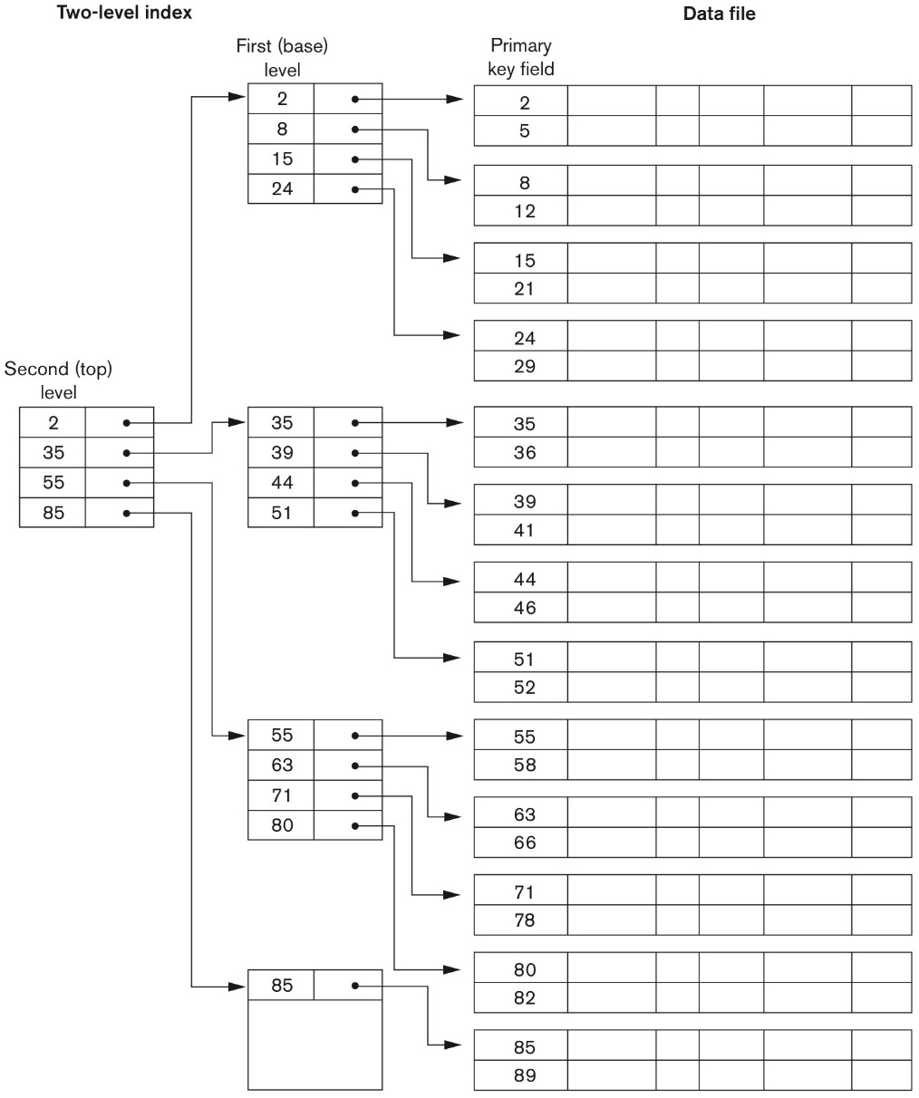
Multilevel Indexes
IBM ISAM file
ISAM is a file management system that allows records to be retrieved sequentially or randomly. ISAM is now obsolete.

Slide 8
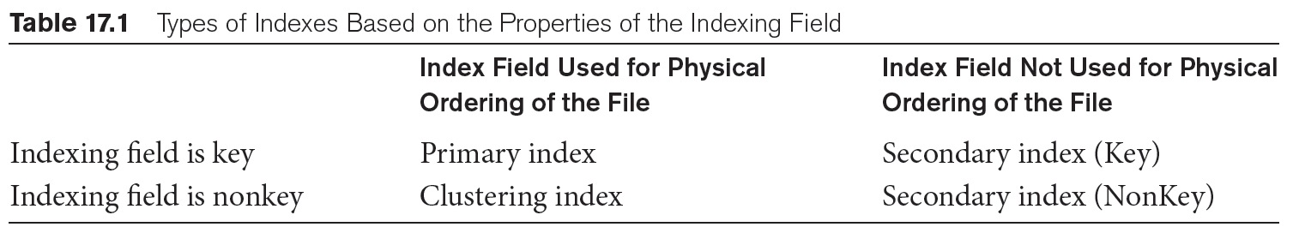
Primary Index vs Secondary Index
The primary index is an ordered file that is fixed length size with two fields. The first field is the same as a primary key and the second field is used to point to the specific data block. In the primary Index, there is always one to one relationship between the entries in the index table and data files (or blocks). The primary Indexing in DBMS is also further divided into two types: (1) Dense Index and (2) Sparse Index.
The secondary index is an index that is not a primary index and may have duplicates.

Slide 9
B+ tree
Search keys
(or Index Entries)
Data Entries
Data Records

Slide 10
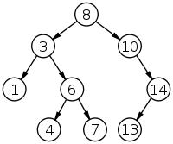
Basic Concept
Root
Parent
Child
Ancestor
Descendant
Leaf
Non-leaf (or internal node)
Level

Slide 11
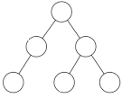
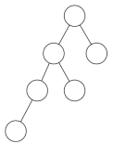
Basic Concept
Balanced Tree
Unbalanced Tree

Slide 12
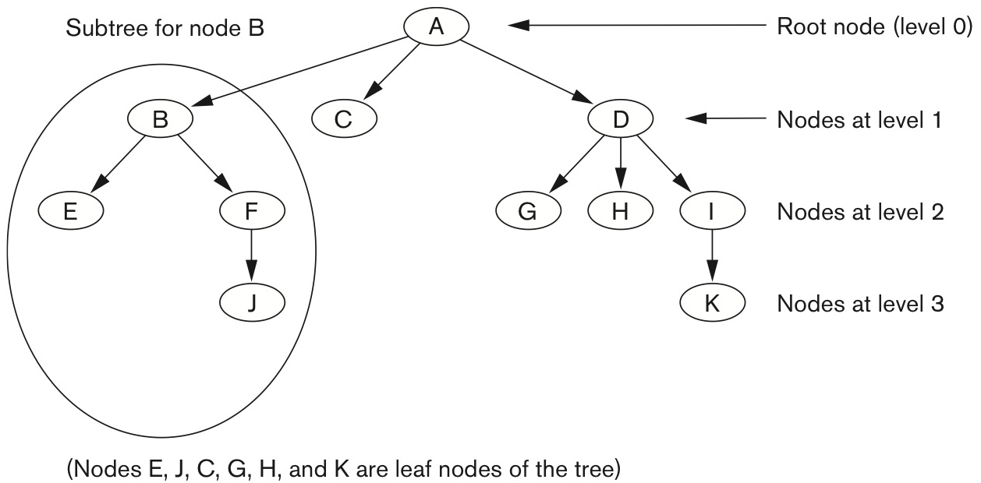
B+ tree

Slide 13
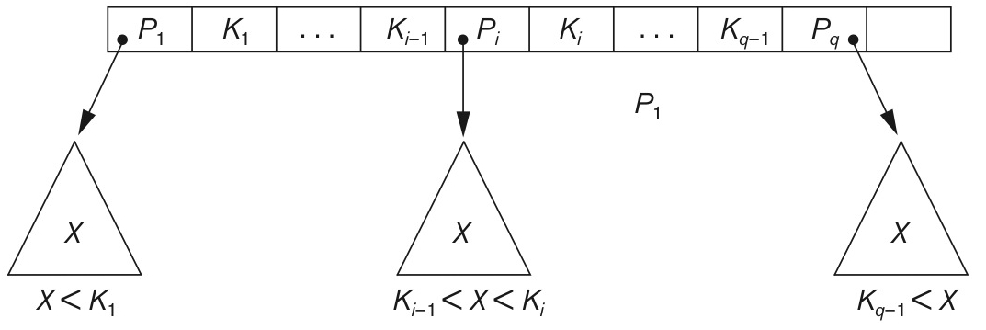
B+ tree
K : q -1 search values
P : q pointers
The number of pointers = order

Slide 14
B+ tree
K1
K2
K3
K4
V < K1
K1 ≤ V < K2
K2 ≤ V < K3
K3 ≤ V < K4
K4 ≤ V
13
17
24
30
2*
3*
5*
7*
14*
16*
19*
20*
22*
24*
27*
29*
33*
34*
38*
39*
Note that how to find the data entry using search Key

Slide 15
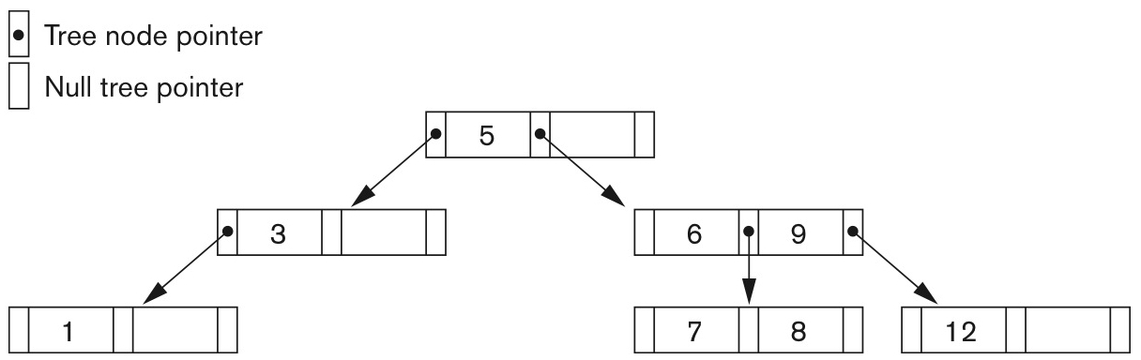
Example ( Search tree of order 3)

Slide 16
B+ tree
The order of the B+ tree (e.g., p) is the maximum number of children (i.e., the number of pointers).
The maximum number of search keys (or data entries) in a node is p-1.
13
17
24
30
2*
3*
5*
7*
14*
16*
19*
20*
22*
24*
27*
29*
33*
34*
38*
39*
In this example, the order of the B+ tree is 5.
5 pointers and 4 search keys (or data entries)

Slide 17
B+ tree
The maximum number of pointers = order
Minimum occupancy of 50% should be guaranteed for every node except the root node.
Search
Insertion / Deletion
Copy Up / Push Up
Redistribution / Merge / Pull Down
Rotation

Slide 18
Inserting a Data Entry into a B+ Tree
Find correct leaf L.
Put data entry onto L.
If L has enough space, done!
Else, must split L (into L and a new node L2)
Redistribute entries evenly, copy up middle key.
Insert index entry pointing to L2 into the parent of L.
This can happen recursively
To split index node, redistribute entries evenly, but push up middle key. (Contrast with leaf splits.)
Splits “grow” tree; root split increases height.
Tree growth: gets wider or one level taller at top.

Slide 19
Deleting a Data Entry from a B+ Tree
Start at the root, find leaf L where entry belongs.
Remove the entry.
If L is at least half-full, done!
If L has only d-1 entries,
Try to re-distribute, borrowing from sibling (adjacent node with the same parent as L).
If re-distribution fails, merge L and sibling.
If merge occurred, must delete the entry (pointing to L or sibling) from the parent of L.
Merge could propagate to the root, decreasing height.

Slide 20
B+ tree
Order of the B+ tree: 5
Minimum occupancy of 50%: 2
13
17
24
30
2*
3*
5*
7*
14*
16*
19*
20*
22*
24*
27*
29*
33*
34*
38*
39*

Slide 21
B+ tree
Before Inserting 25
13
17
24
30
2*
3*
5*
7*
14*
16*
19*
20*
22*
24*
27*
29*
33*
34*
38*
39*

Slide 22
B+ tree
After Inserting 25
13
17
24
30
2*
3*
5*
7*
14*
16*
19*
20*
22*
24*
25*
27*
29*
33*
34*
38*
39*

Slide 23
B+ tree
Before Inserting 8
13
17
24
30
2*
3*
5*
7*
14*
16*
19*
20*
22*
24*
27*
29*
33*
34*
38*
39*

Slide 24
B+ tree
After Inserting 8
13
17
24
30
2*
3*
5*
7*
8*
14*
16*
19*
20*
22*
24*
27*
29*
33*
34*
38*
39*

Slide 25
B+ tree
After Inserting 8
copy up
5
13
17
24
30
14*
16*
19*
20*
22*
24*
27*
29*
33*
34*
38*
39*
2*
3*
5*
7*
8*

Slide 26
B+ tree
After Inserting 8
push up
17
5
13
24
30
2*
3*
5*
7*
8*
14*
16*
19*
20*
22*
24*
27*
29*
33*
34*
38*
39*

Slide 27
B+ tree
Before Deleting 19
17
5
13
24
30
2*
3*
5*
7*
8*
14*
16*
19*
20*
22*
24*
27*
29*
33*
34*
38*
39*

Slide 28
B+ tree
After Deleting 19
17
5
13
24
30
2*
3*
5*
7*
8*
14*
16*
20*
22*
24*
27*
29*
33*
34*
38*
39*

Slide 29
B+ tree
Before Deleting 20
17
5
13
24
30
2*
3*
5*
7*
8*
14*
16*
20*
22*
24*
27*
29*
33*
34*
38*
39*

Slide 30
B+ tree
After Deleting 20
17
5
13
24
30
2*
3*
5*
7*
8*
14*
16*
22*
24*
27*
29*
33*
34*
38*
39*
redistribution

Slide 31
B+ tree
After Deleting 20
17
5
13
27
30
2*
3*
5*
7*
8*
14*
16*
22*
24*
27*
29*
33*
34*
38*
39*

Slide 32
B+ tree
Before Deleting 24
17
5
13
27
30
2*
3*
5*
7*
8*
14*
16*
22*
24*
27*
29*
33*
34*
38*
39*

Slide 33
B+ tree
After Deleting 24
17
5
13
27
30
2*
3*
5*
7*
8*
14*
16*
22*
27*
29*
33*
34*
38*
39*
merge

Slide 34
B+ tree
After Deleting 24
17
pull down
5
13
30
2*
3*
5*
7*
8*
14*
16*
22*
27*
29*
33*
34*
38*
39*

Slide 35
B+ tree
After Deleting 24
5
13
17
30
2*
3*
5*
7*
8*
14*
16*
22*
27*
29*
33*
34*
38*
39*

Slide 36
B+ tree
After Deleting 24
5
13
17
30
2*
3*
5*
7*
8*
14*
16*
22*
27*
29*
33*
34*
38*
39*

Slide 37
B+ tree with Clustered and Unclustered Files
Suppose that <k, rid> is used for data entries and that the data records are stored in a Heap file.
To build clustered index, first sort the Heap file (with some free space on each page for future inserts).
Overflow pages may be needed for inserts. (Thus, order of data recs is ‘close to’, but not identical to, the sort order.)
Index entries
UNCLUSTERED
CLUSTERED
direct search for
data entries
Data entries
Data entries
(Index File)
(Data file)
Data Records
Data Records

Slide 38
External Sorting
A classic problem in computer science!
Data requested in sorted order
e.g., find students in increasing GPA order
Sorting is first step in bulk loading B+ tree index.
Sorting useful for eliminating duplicate copies in a collection of records (Why?)
Sort-merge join algorithm involves sorting.
Problem: sort 1Gb of data with 1Mb of RAM.
why not virtual memory?

Slide 39
Two-Way Sort: Requires 3 Buffers
Pass 1: Read a page, sort it, write it.
only one buffer page is used
Pass 2, 3, …, etc.:
three buffer pages used.
INPUT 1
OUTPUT
INPUT 2
Main memory buffers
Disk
Disk

Slide 40
Two-Way External Merge Sort
Each pass we read + write each page in file.
N pages in the file → the number of passes
So toal cost is:
Idea: Divide and conquer: sort subfiles and merge
3,4
6,2
9,4
8,7
5,6
3,1
2
Input file
PASS 0
3,4
2,6
4,9
7,8
5,6
1,3
2
1-page runs
PASS 1
2,3
4,7
1,3
2-page runs
4,6
8,9
5,6
2
PASS 2
2,3
4,4
1,2
4-page runs
6,7
3,5
8,9
6
PASS 3
1,2
2,3
3,4
8-page runs
4,5
6,6
7,8
9

Slide 41
External Merge Sort
{3, 4}, {6, 2}, {9, 4}, {8, 7}, {5, 6}, {3, 1}, {2}
3,4
6,2
9,4
8,7
5,6
3,1
2
Input file
PASS 0
3,4
2,6
4,9
7,8
5,6
1,3
2
1-page runs

Slide 42
External Merge Sort
{3, 4}, {2, 6}, {4, 9}, {7, 8}, {5, 6}, {1, 3}, {2}
3,4
2,6
4,9
7,8
5,6
1,3
2
1-page runs
PASS 1
2,3
4,7
1,3
2-page runs
4,6
8,9
5,6
2

Slide 43
External Merge Sort
{2, 3, 4, 6}, {4, 7, 8, 9}, {1, 2, 3, 5}, {6}
2,3
4,7
1,3
2-page runs
4,6
8,9
5,6
2
PASS 2
2,3
4,4
1,2
4-page runs
6,7
3,5
8,9
6

Slide 44
External Merge Sort
{2, 3, 4, 4, 6, 7, 8, 9}, {1, 2, 3, 5, 6}
2,3
4,4
1,2
4-page runs
6,7
3,5
8,9
6
PASS 3
1,2
2,3
3,4
4,5
8-page runs
6,6
7,8
9

Slide 45
General External Merge Sort
More than 3 buffer pages. How can we utilize them?
To sort a file with N pages using B buffer pages:
Pass 0: use B buffer pages. Produce sorted runs of B pages each.
Pass 2, …, etc.: merge B-1 runs.
INPUT 1
. . .
INPUT 2
. . .
. . .
OUTPUT
INPUT B-1
Disk
Disk
B Main memory buffers

Slide 46
Cost of External Merge Sort
Number of passes:
Cost = 2N * (# of passes)
E.g., with 5 buffer pages, to sort 108 page file:
Pass 0: = 22 sorted runs of 5 pages each (last run is only 3 pages)
Pass 1: = 6 sorted runs of 20 pages each (last run is only 8 pages)
Pass 2: 2 sorted runs, 80 pages and 28 pages
Pass 3: Sorted file of 108 pages

Slide 47
Number of Passes of External Sort

Slide 48
Bitmap Indexes
A bitmap index is a B+-tree index using a bitmap representation for each key at the leaf level instead of a list of row identifiers (RID-list).
A "bitmap" B is defined on a table T = {r₁. r₂, ..., r_{n}} as a sequence of M bits, where M ≥ n.
A small number of unique values.

Slide 49
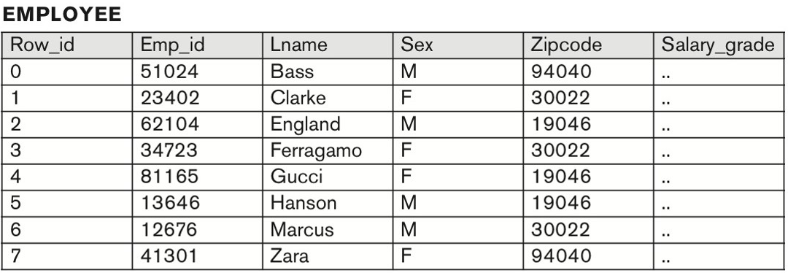
Bitmap Indexes
Which column has a small number of unique values?

Slide 50
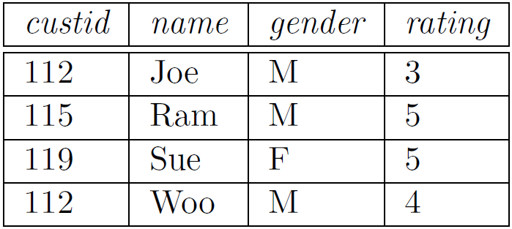
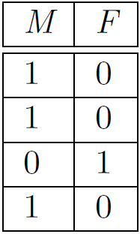
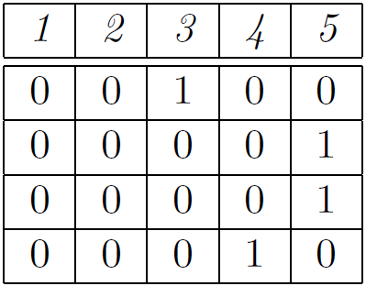
Bitmap Indexes
Bitmap Indexes on Customers Relation
gender
rating
Can we create a bitmap index for name?

Slide 51
Bitmap Indexes
The bitmap index can be used for the columns that have low cardinality.
Maintaining a bitmap index takes a lot of resources. For example, each time a new record is entered, we may modify the bitmap index throughout, which is tedious and time-consuming. Therefore, bitmap indexes are only good for the read-only tables or tables that have infrequent updates.
You often find bitmap indexes are extensively used in the data warehouse environment.

Slide 52
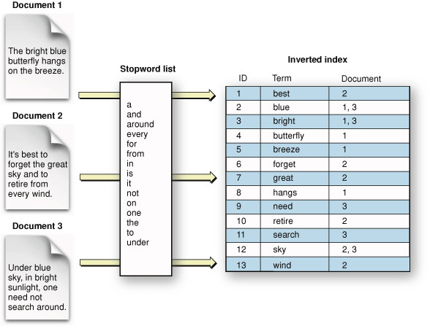
Inverted Index
An Inverted Index is a data structure that enables fast retrieval of all documents that contain a query term.
For each term, the index maintains a list (i.e., inverted list) of entries describing occurrences of the term, with one entry per document that contains the term.

Slide 53
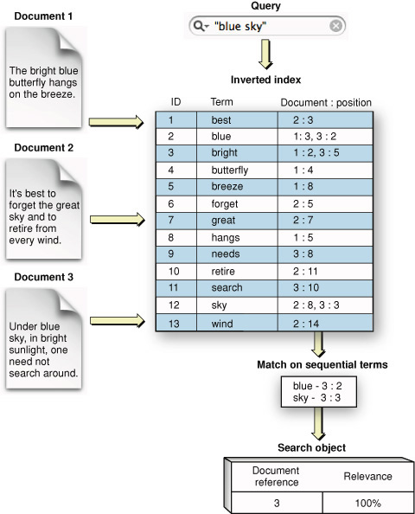
Inverted Index
An inverted index is a simple but powerful way to search documents, images, media, and even data

Slide 54
Multi-Attribute Access Methods
Many queries however usually involve many attributes.
Consider, for example, "find the employees with salary> 50,000 working in dept A".
This query could still be addressed by a single-attribute index, however not very efficiently.
If an index exists on the salary attribute, this index would be used to find all employees with salaries greater than 50,000. Each returned record must then be checked whether it has dept = ‘A’.

Slide 55
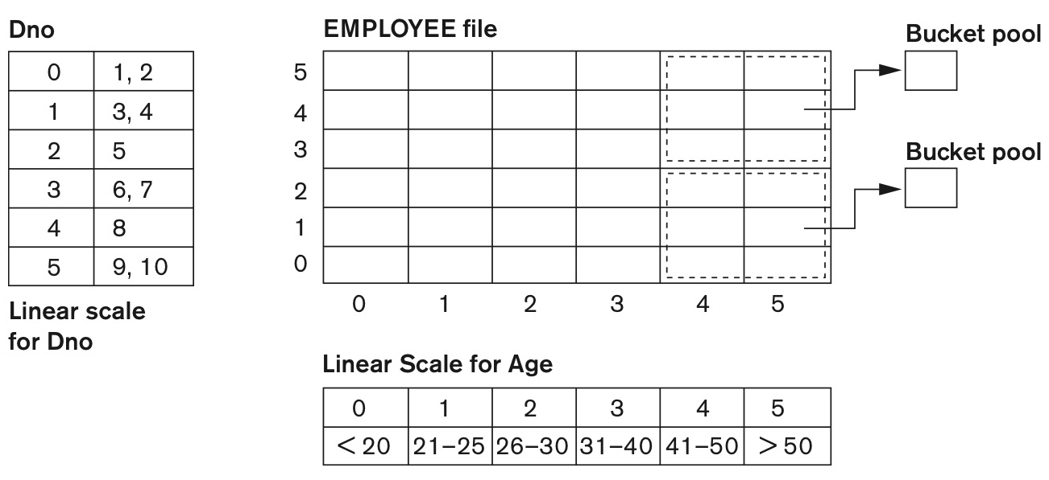
Grid Files (Multiple Keys)
The Grid File can be thought of as a generalization of dynamic hashing in multiple dimensions.

Slide 56
Grid Files (Multiple Keys)
The Grid File imposes a grid on the two-dimensional attribute space. Each cell in this grid corresponds to one data page.
The data point that “falls" inside a given cell, is stored in the cell's corresponding page. Each cell must thus store a pointer to its corresponding page.
This information is stored in the Grid File's directory.

Slide 57
R tree (Multiple Keys)
R-trees were originally proposed by Guttman as a direct extension of B+-trees in n-dimensional space.
The data structure is a height-balanced tree that consists of intermediate and leaf nodes. A leaf node is a collection of entries of the form (o_id, R) where o_id is an object identifier, used to refer to an object in the database, and R is the MBR approximation of the data object.
An intermediate node is a collection of entries of the form (ptr, R) where ptr is a pointer to a lower-level node of the tree and R is a representation of the minimum rectangle that encloses all MBRs of the lower-level node entries.

Slide 58
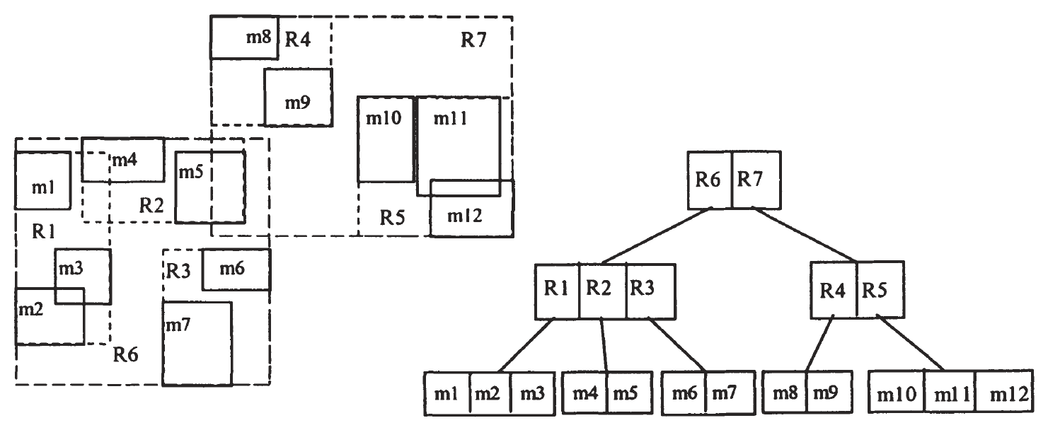
R tree (Multiple Keys)
In order for a new entry E to be inserted into the R-tree, starting from the root node we choose its child that needs minimum enlargement to include E (ties are resolved by choosing the one with the smallest area).

Slide 59
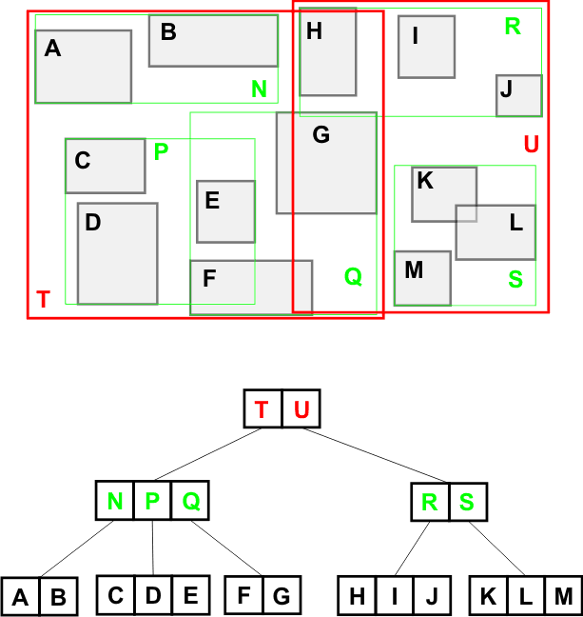
R tree

Slide 60
CREATE INDEX
CREATE INDEX ord_customer_idx
ON orders (customer_id);
CREATE INDEX employees_idx
ON employees (last_name, job_id, salary);
CREATE BITMAP INDEX emp_bitmap_idx
ON employee (gender);

Slide 61
Take home message
Primary Index
Clustering Index
Multi-level Index
B+ tree
External Merge Sort

